Slide 1

Flexbox helper
Based on the original:

Slide 2
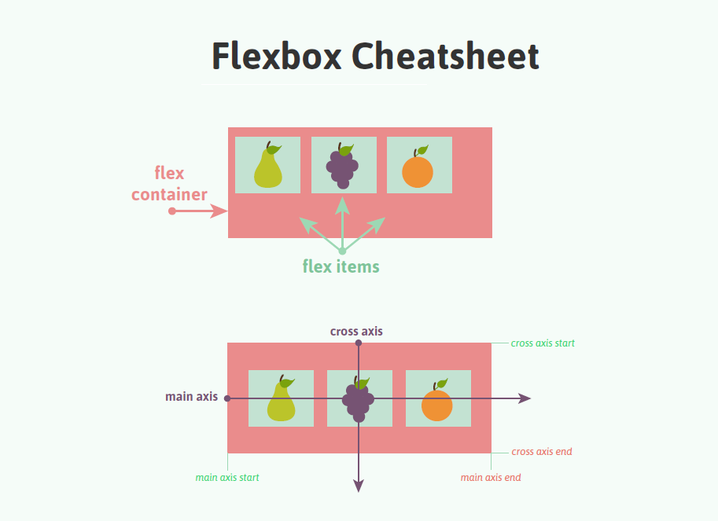
Essential Terminology & Concepts

Slide 3
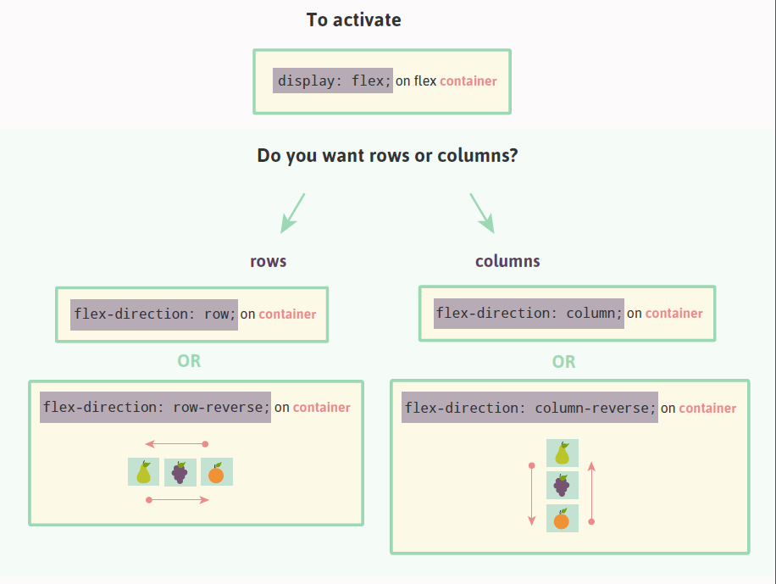
To begin, designate a flex-container…

Slide 4
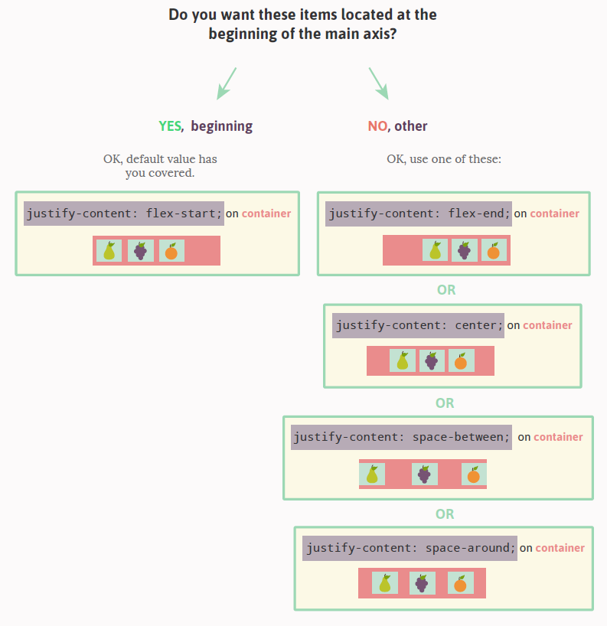
Specify display behavior of flex-items in regard to the primary (main) axis…

Slide 5
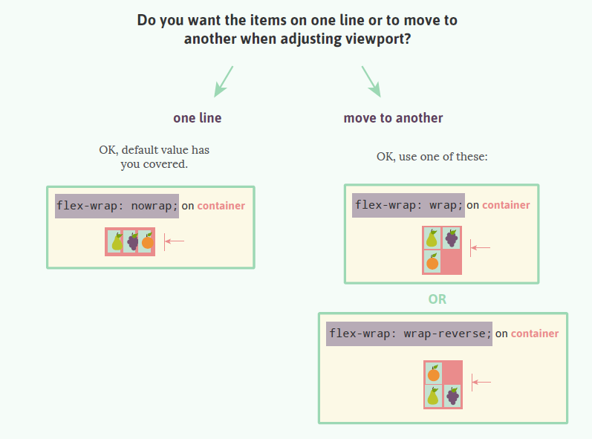
Specify display behavior of flex-items in regard to viewport width changes…

Slide 6
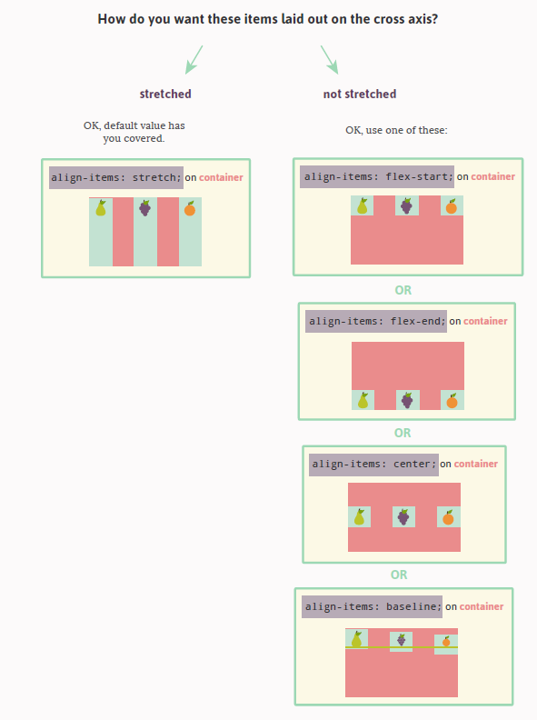
Specify display behavior of flex-items in regard to the secondary (cross) axis…

Slide 7
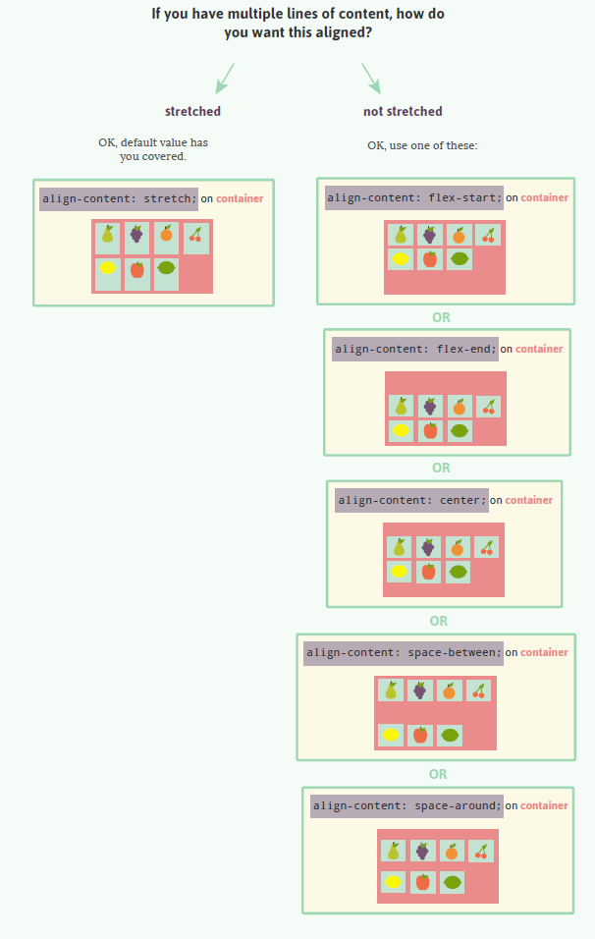
Specify display behavior of flex-items when there are more than can fit on a single line…

Slide 8
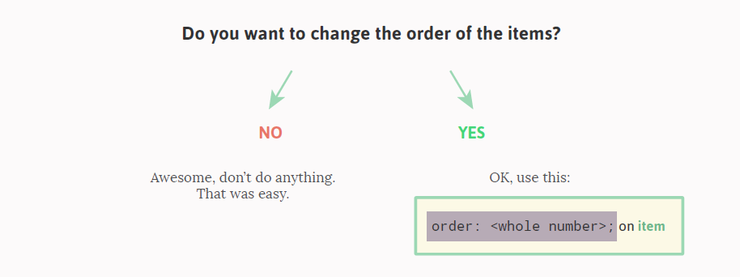
Specify display behavior of flex-items in regard to the order displayed…
Note: when we say “order” above, we strictly mean display order

Slide 9
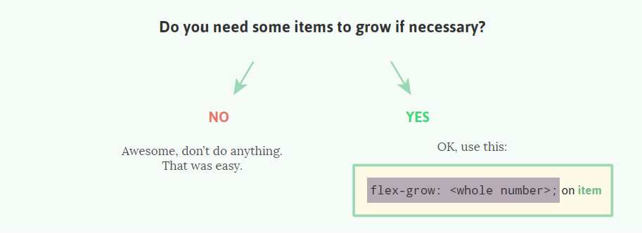
Specify display behavior of flex-items in regard to increasing size to use up excess display space…
Note: for some reason, the property “flex-shrink” was omitted in the original guide. It functions (roughly) as the opposite of this property. It specifies behavior when excess display is reduced.

Slide 10
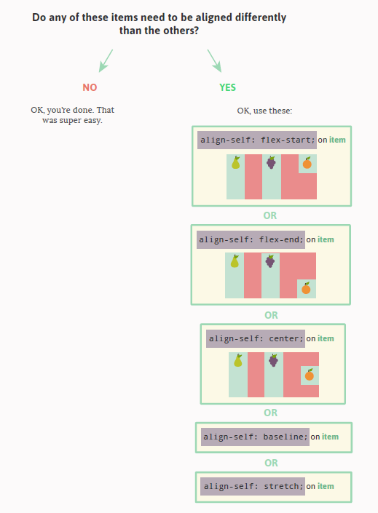
Specify display behavior of a single flex-items in regard to alignment…

